Slide 1

Improvi
Go, change the world
RV College of
Engineering
Unit 4
Part-1
Transaction Processing Concepts and Theory
Original Content: Ramez Elmasri and Shamkant B. Navathe

Slide 2

Go, change the world
RV College of
Engineering
Chapter Outline
1 Introduction to Transaction Processing
2 Transaction and System Concepts
3 Desirable Properties of Transactions
4 Characterizing Schedules based on Recoverability
5 Characterizing Schedules based on Serializability
6 Transaction Support in SQL

Slide 3
Introduction to Transaction Processing
Go, change the world
RV College of
Engineering
Single-User System:
At most one user at a time can use the system.
Multiuser System:
Many users can access the system concurrently.
Concurrency
Interleaved processing:
Concurrent execution of processes is interleaved in a single CPU
Parallel processing:
Processes are concurrently executed in multiple CPUs.

Slide 4
Introduction to Transaction Processing
Go, change the world
RV College of
Engineering
A Transaction:
Logical unit of database processing that includes one or more access operations (read -retrieval, write - insert or update, delete).
A transaction (set of operations) may be stand-alone specified in a high level language like SQL submitted interactively, or may be embedded within a program.
Transaction boundaries:
Begin and End transaction.
An application program may contain several transactions separated by the Begin and End transaction boundaries.

Slide 5
Introduction to Transaction Processing
Go, change the world
RV College of
Engineering
SIMPLE MODEL OF A DATABASE (for purposes of discussing transactions):
A database is a collection of named data items
Granularity of data - a field, a record , or a whole disk block (Concepts are independent of granularity)
Basic operations are read and write
read_item(X): Reads a database item named X into a program variable. To simplify our notation, we assume that the program variable is also named X.
write_item(X): Writes the value of program variable X into the database item named X.

Slide 6
Introduction to Transaction Processing
Go, change the world
RV College of
Engineering
READ AND WRITE OPERATIONS:
Basic unit of data transfer from the disk to the computer main memory is one block. In general, a data item (what is read or written) will be the field of some record in the database, although it may be a larger unit such as a record or even a whole block.
read_item(X) command includes the following steps:
Find the address of the disk block that contains item X.
Copy that disk block into a buffer in main memory (if that disk block is not already in some main memory buffer).
Copy item X from the buffer to the program variable named X.

Slide 7
Introduction to Transaction Processing
Go, change the world
RV College of
Engineering
READ AND WRITE OPERATIONS (contd.):
write_item(X) command includes the following steps:
Find the address of the disk block that contains item X.
Copy that disk block into a buffer in main memory (if that disk block is not already in some main memory buffer).
Copy item X from the program variable named X into its correct location in the buffer.
Store the updated block from the buffer back to disk (either immediately or at some later point in time).

Slide 8
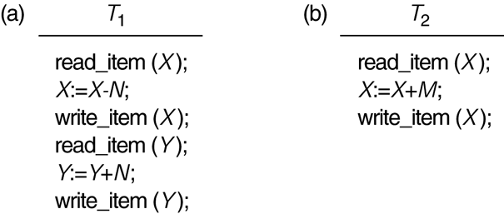
Two sample transactions
Go, change the world
RV College of
Engineering

Slide 9
Why Concurrency Control is needed:
Go, change the world
RV College of
Engineering
The Lost Update Problem
This occurs when two transactions that access the same database items have their operations interleaved in a way that makes the value of some database item incorrect.
The Temporary Update (or Dirty Read) Problem
This occurs when one transaction updates a database item and then the transaction fails for some reason
The updated item is accessed by another transaction before it is changed back to its original value.
The Incorrect Summary Problem
If one transaction is calculating an aggregate summary function on a number of records while other transactions are updating some of these records, the aggregate function may calculate some values before they are updated and others after they are updated.

Slide 10
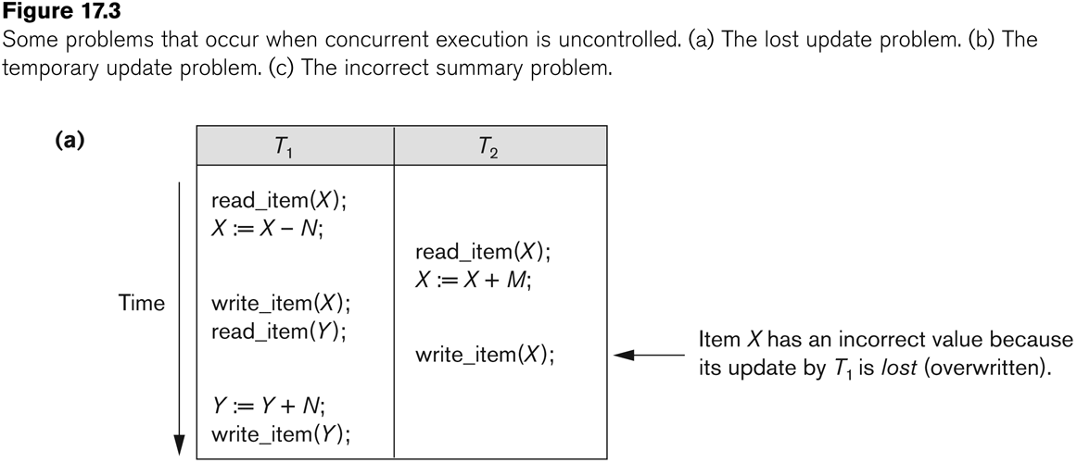
Go, change the world
RV College of
Engineering
Concurrent execution is uncontrolled:
(a) The lost update problem.

Slide 11
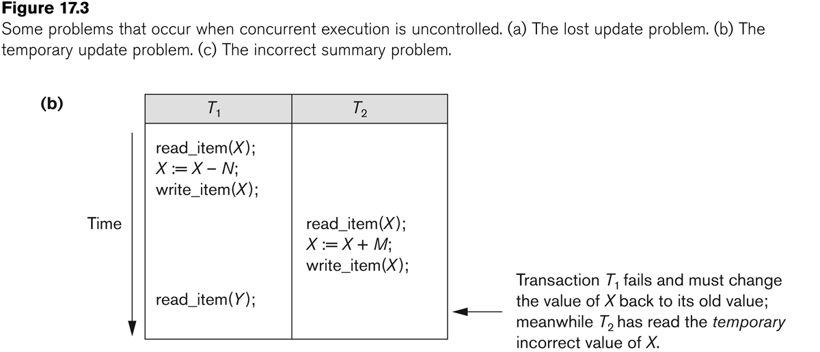
Go, change the world
RV College of
Engineering
Concurrent execution is uncontrolled:
(b) The temporary update problem.

Slide 12
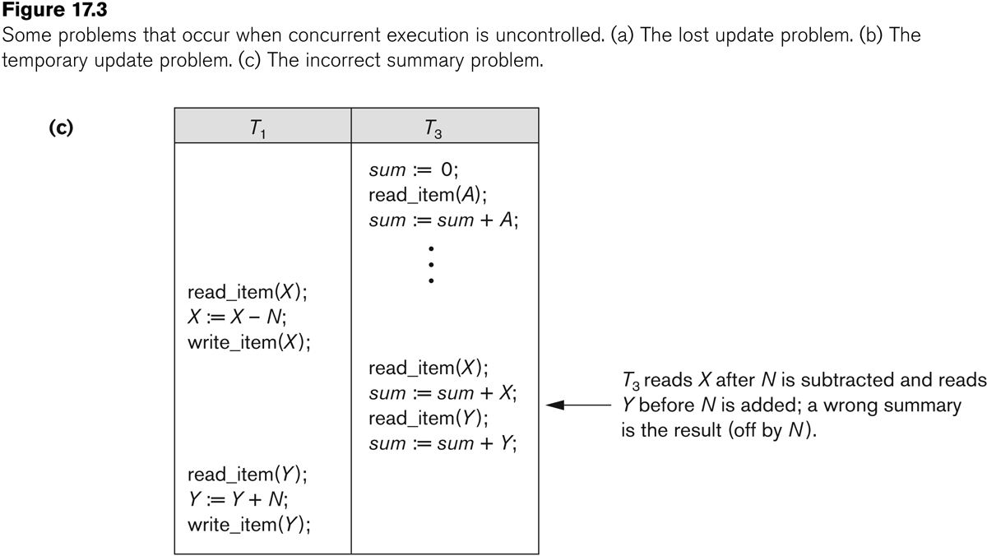
Go, change the world
RV College of
Engineering
Concurrent execution is uncontrolled:
(c) The incorrect summary problem.

Slide 13
Why recovery is needed:
Go, change the world
RV College of
Engineering
(What causes a Transaction to fail)
1. A computer failure (system crash):
A hardware or software error occurs in the computer system during transaction execution. If the hardware crashes, the contents of the computer’s internal memory may be lost.
2. A transaction or system error:
Some operation in the transaction may cause it to fail, such as integer overflow or division by zero. Transaction failure may also occur because of erroneous parameter values or because of a logical programming error. In addition, the user may interrupt the transaction during its execution.

Slide 14
Why recovery is needed:
Go, change the world
RV College of
Engineering
3. Local errors or exception conditions detected by the transaction:
Certain conditions necessitate cancellation of the transaction. For example, data for the transaction may not be found. A condition, such as insufficient account balance in a banking database, may cause a transaction, such as a fund withdrawal from that account, to be canceled.
A programmed abort in the transaction causes it to fail.
4. Concurrency control enforcement:
The concurrency control method may decide to abort the transaction, to be restarted later, because it violates serializability or because several transactions are in a state of deadlock

Slide 15
Why recovery is needed:
Go, change the world
RV College of
Engineering
5. Disk failure:
Some disk blocks may lose their data because of a read or write malfunction or because of a disk read/write head crash. This may happen during a read or a write operation of the transaction.
6. Physical problems and catastrophes:
This refers to an endless list of problems that includes power or air-conditioning failure, fire, theft, sabotage, overwriting disks or tapes by mistake, and mounting of a wrong tape by the operator.

Slide 16
Transaction and System Concepts
Go, change the world
RV College of
Engineering
A transaction is an atomic unit of work that is either completed in its entirety or not done at all.
For recovery purposes, the system needs to keep track of when the transaction starts, terminates, and commits or aborts.
Transaction states:
Active state
Partially committed state
Committed state
Failed state
Terminated State

Slide 17
Transaction and System Concepts
Go, change the world
RV College of
Engineering
Recovery manager keeps track of the following operations:
begin_transaction: This marks the beginning of transaction execution.
read or write: These specify read or write operations on the database items that are executed as part of a transaction.
end_transaction: This specifies that read and write transaction operations have ended and marks the end limit of transaction execution.
At this point it may be necessary to check whether the changes introduced by the transaction can be permanently applied to the database or whether the transaction has to be aborted because it violates concurrency control or for some other reason.

Slide 18
Transaction and System Concepts
Go, change the world
RV College of
Engineering
Recovery manager keeps track of the following operations (cont):
commit_transaction: This signals a successful end of the transaction so that any changes (updates) executed by the transaction can be safely committed to the database and will not be undone.
rollback (or abort): This signals that the transaction has ended unsuccessfully, so that any changes or effects that the transaction may have applied to the database must be undone.

Slide 19
Go, change the world
RV College of
Engineering
Recovery techniques use the following operators:
undo: Similar to rollback except that it applies to a single operation rather than to a whole transaction.
redo: This specifies that certain transaction operations must be redone to ensure that all the operations of a committed transaction have been applied successfully to the database.

Slide 20
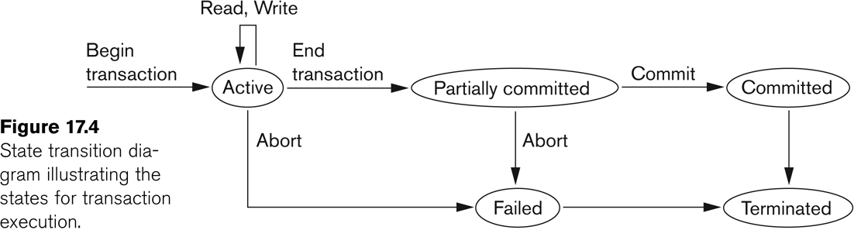
State transition diagram
Go, change the world
RV College of
Engineering

Slide 21
Go, change the world
RV College of
Engineering
The System Log
Log or Journal: The log keeps track of all transaction operations that affect the values of database items.
This information may be needed to permit recovery from transaction failures.
The log is kept on disk, so it is not affected by any type of failure except for disk or catastrophic failure.
In addition, the log is periodically backed up to archival storage (tape) to guard against such catastrophic failures.

Slide 22
Go, change the world
RV College of
Engineering
The System Log (cont):
T in the following discussion refers to a unique transaction-id that is generated automatically by the system and is used to identify each transaction:
Types of log record:
[start_transaction,T]: Records that transaction T has started execution.
[write_item,T,X,old_value,new_value]: Records that transaction T has changed the value of database item X from old_value to new_value.
[read_item,T,X]: Records that transaction T has read the value of database item X.
[commit,T]: Records that transaction T has completed successfully, and affirms that its effect can be committed (recorded permanently) to the database.
[abort,T]: Records that transaction T has been aborted.

Slide 23
Go, change the world
RV College of
Engineering
The System Log (cont):
Protocols for recovery that avoid cascading rollbacks do not require that read operations be written to the system log, whereas other protocols require these entries for recovery.
Strict protocols require simpler write entries that do not include new_value

Slide 24
Go, change the world
RV College of
Engineering
Recovery using log records:
If the system crashes, we can recover to a consistent database state by examining the log and using one of the techniques described in Chapter 19.
Because the log contains a record of every write operation that changes the value of some database item, it is possible to undo the effect of these write operations of a transaction T by tracing backward through the log and resetting all items changed by a write operation of T to their old_values.
We can also redo the effect of the write operations of a transaction T by tracing forward through the log and setting all items changed by a write operation of T (that did not get done permanently) to their new_values.

Slide 25
Go, change the world
RV College of
Engineering
Commit Point of a Transaction:
Definition a Commit Point:
A transaction T reaches its commit point when all its operations that access the database have been executed successfully and the effect of all the transaction operations on the database has been recorded in the log.
Beyond the commit point, the transaction is said to be committed, and its effect is assumed to be permanently recorded in the database.
The transaction then writes an entry [commit,T] into the log.
Roll Back of transactions:
Needed for transactions that have a [start_transaction,T] entry into the log but no commit entry [commit,T] into the log.

Slide 26
Go, change the world
RV College of
Engineering
Commit Point of a Transaction (cont):
Redoing transactions:
Transactions that have written their commit entry in the log must also have recorded all their write operations in the log; otherwise they would not be committed, so their effect on the database can be redone from the log entries. (Notice that the log file must be kept on disk.
At the time of a system crash, only the log entries that have been written back to disk are considered in the recovery process because the contents of main memory may be lost.)
Force writing a log:
Before a transaction reaches its commit point, any portion of the log that has not been written to the disk yet must now be written to the disk.
This process is called force-writing the log file before committing a transaction.

Slide 27
Desirable Properties of Transactions
Go, change the world
RV College of
Engineering
ACID properties:
Atomicity: A transaction is an atomic unit of processing; it is either performed in its entirety or not performed at all.
Consistency preservation: A correct execution of the transaction must take the database from one consistent state to another.
Isolation: A transaction should not make its updates visible to other transactions until it is committed; this property, when enforced strictly, solves the temporary update problem and makes cascading rollbacks of transactions unnecessary (see Chapter 21).
Durability or permanency: Once a transaction changes the database and the changes are committed, these changes must never be lost because of subsequent failure.

Slide 28
Go, change the world
RV College of
Engineering
Schedule
Schedule
Schedules
Schedules
Serial Schedules and Non-serial Schedules
Complete Schedules
Serializable Schedules
Classifying Schedules based on Recoverability
Recoverable and Non Recoverable Schedules
Cascading roll back schedules
Cascade less Schedules
Strict Schedules
Classifying Schedules based on Serializability
Conflict serializable
Testing for Conflict Serializability

Slide 29
Go, change the world
RV College of
Engineering
Schedule Definition
Schedule Definition
Schedule Definition
Transaction schedule or history:
When transactions are executing concurrently in an interleaved fashion, the order of execution of operations from the various transactions forms (is known as) a transaction schedule (or history).
A schedule (or history) S of n transactions T1, T2, …, Tn:
It is an ordering of the operations of the transactions subject to the constraint that, for each transaction Ti that participates in S, the operations of Ti in S must appear in the same order in which they occur in Ti.
Note, however, that operations from other transactions Tj can be interleaved with the operations of Ti in S.

Slide 30
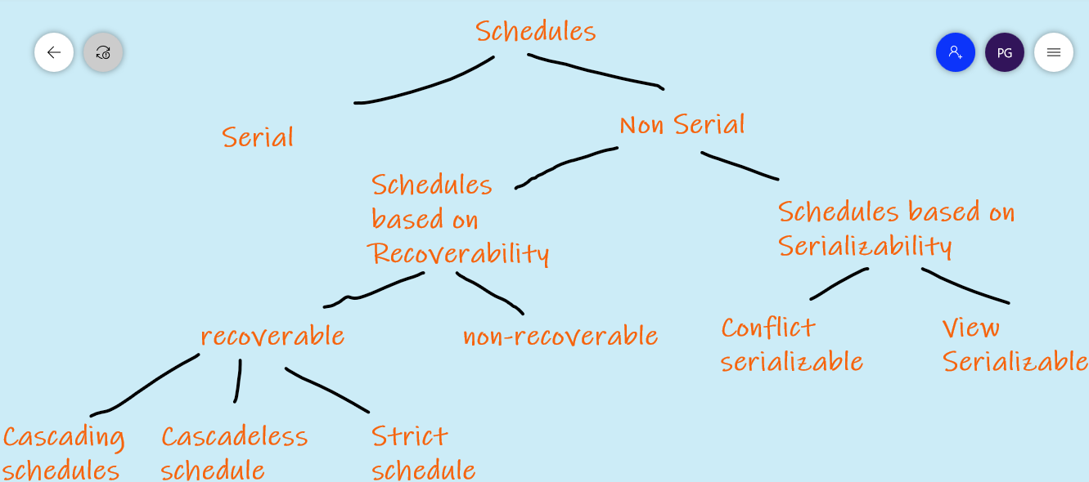
Go, change the world
RV College of
Engineering
Types of Schedules in Database

Slide 31
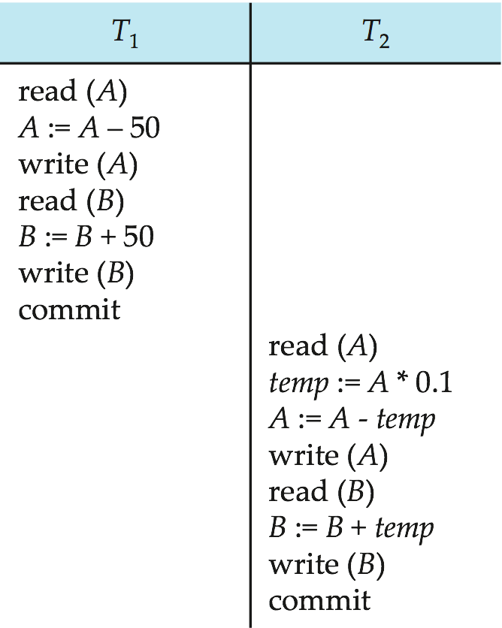
Go, change the world
RV College of
Engineering
Serial Schedule 1
Let T₁ transfer $50 from A to B, and T₂ transfer 10% of the balance from A to B.
A serial schedule in which T₁ is followed by T₂ :

Slide 32
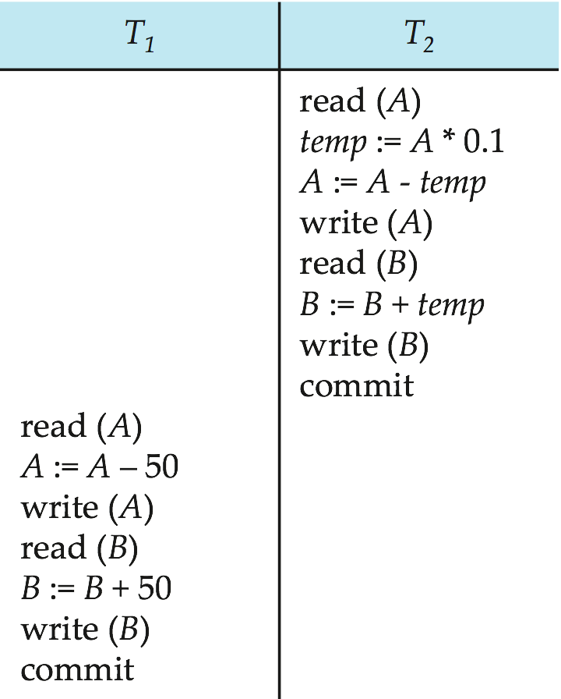
Go, change the world
RV College of
Engineering
Serial Schedule 2
A serial schedule where T₂ is followed by T₁

Slide 33
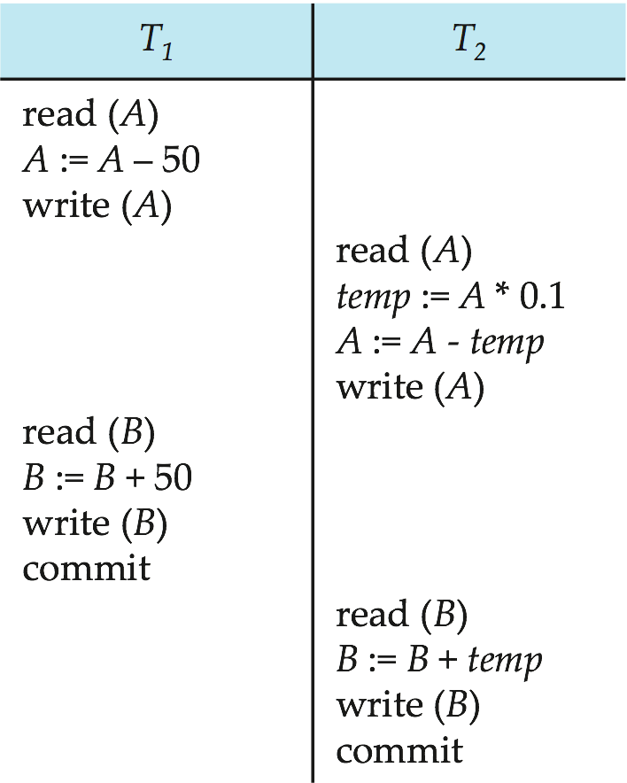
Go, change the world
RV College of
Engineering
Serializable Schedule 3
Let T₁ and T₂ be the transactions defined previously. The following schedule is not a serial schedule, but it is equivalent to Schedule 1.
In Schedules 1, 2 and 3, the sum A + B is preserved.

Slide 34
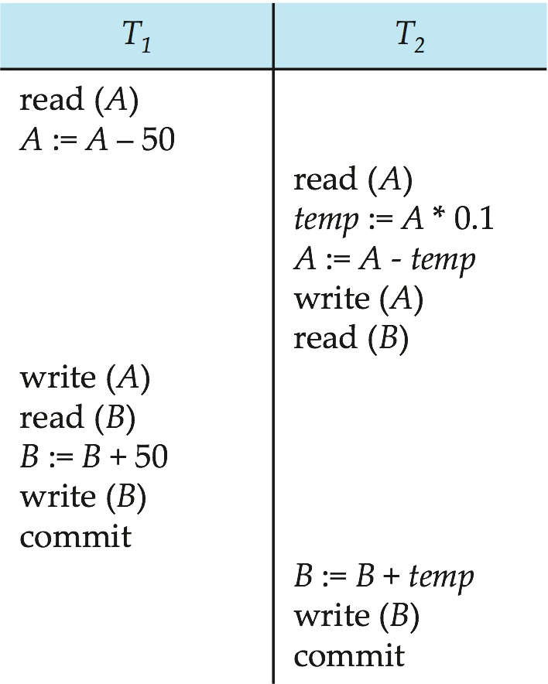
Go, change the world
RV College of
Engineering
Schedule 4
The following concurrent schedule does not preserve the value of (A + B ).

Slide 35
Go, change the world
RV College of
Engineering
Notations used for describing the schedules
For the purpose of recovery and concurrency control, we are mainly interested in the read_item and write_item operations of the transactions, as well as the commit and abort operations.
A shorthand notation for describing a schedule uses the symbols b, r, w, e, c, and a for the operations begin_transaction, read_item, write_item, end_transaction, commit, and abort, respectively, and appends as a subscript the transaction id (transaction number) to each operation in the schedule.

Slide 36
Go, change the world
RV College of
Engineering
Example – Shorthand notation for Schedule
Sa: r1(X); r2(X); w1(X); r1(Y); w2(X); w1(Y);a1;

Slide 37
Go, change the world
RV College of
Engineering
Example – Shorthand notation for Schedule
Sb: r1(X); w1(X); r2(X); w2(X); r1(Y); a1;

Slide 38
Go, change the world
RV College of
Engineering
Characterizing Schedules based on Recoverability
Schedules classified on recoverability:
Recoverable schedule:
Schedule where no transaction needs to be rolled back once the transaction is committed.
This ensures that the durability property of transactions is not violated.
A schedule where a committed transaction may have to be rolled back during recovery is called non-recoverable and hence should not be permitted by the DBMS.

Slide 39
Go, change the world
RV College of
Engineering
Characterizing Schedules based on Recoverability
Recoverable schedule:
A schedule S is recoverable if no transaction T in S commits until all transactions T’ that have written an item that T reads have committed.
In other words, if some transaction T_{j} is reading value updated or written by some other transaction T_{i}, then the commit of T_{j} must occur after the commit of T_{i}.
S1: R1(x), W1(x), R2(x), R1(y), R2(y), W2(x), W1(y), C1, C2; (R)
Sc: r1(X); w1(X); r2(X); r1(Y); w2(X); c2; a1; (NR)

Slide 40
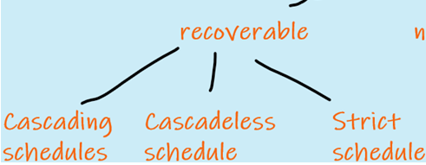
Go, change the world
RV College of
Engineering
Characterizing Schedules based on Recoverability
Sd: r1(X); w1(X); r2(X); r1(Y); w2(X); w1(Y); c1; c2; (R)
Se: r1(X); w1(X); r2(X); r1(Y); w2(X); w1(Y); a1; a2; (R but cascading Rollback)
Sa′: r1(X); r2(X); w1(X); r1(Y); w2(X); c2; w1(Y); c1; (R)
Sb: r1(X); w1(X); r2(X); w2(X); r1(Y); a1;

Slide 41
Go, change the world
RV College of
Engineering
Characterizing Schedules based on Recoverability
Because cascading rollback can be time-consuming—since numerous transactions can be rolled back it is important to characterize the schedules where this phenomenon is guaranteed not to occur.
Cascadeless schedule:
A schedule is said to be cascadeless, or to avoid cascading rollback, if every transaction in the schedule reads only items that were written by committed transactions.
To satisfy this criterion, the r2(X) command in schedules Sd and Se must be postponed until after T1 has committed (or aborted), thus delaying T2 but ensuring no cascading rollback if T1 aborts.
Sf : w1(X, 5); w2(X, 8); a1; (Cascadeless)

Slide 42
Go, change the world
RV College of
Engineering
Characterizing Schedules based on Recoverability
Schedules classified on recoverability (contd.):
Cascaded rollback Schedules:
A schedule in which uncommitted transactions that read an item from a failed transaction must be rolled back.
Se: r1(X); w1(X); r2(X); r1(Y); w2(X); w1(Y); a1; a2; (R but cascading Rollback)
Strict Schedules:
A schedule in which a transaction can neither read or write an item X until the last transaction that wrote X has committed.
The schedule Sf is cascadeless, but it is not a strict schedule, since it permits T2 to write item X even though the transaction T1 that last wrote X had not yet committed

Slide 43
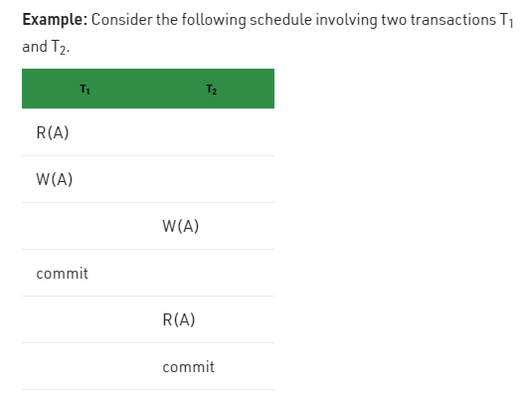
Go, change the world
RV College of
Engineering
Characterizing Schedules based on Recoverability
r1(a);w1(a);w2(a);c1;r2(a);c2;

Slide 44
Go, change the world
RV College of
Engineering
Characterizing Schedules based on Recoverability
This schedule is cascadeless. Since the updated value of A is read by T₂ only after the updating transaction i.e. T₁ commits.

Slide 45
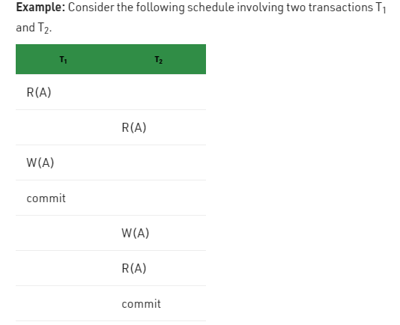
Go, change the world
RV College of
Engineering
Characterizing Schedules based on Recoverability
r1(a);r2(a);w1(a);c1;w2(a);r2(a);c2

Slide 46
Go, change the world
RV College of
Engineering
Characterizing Schedules based on Recoverability
This is a strict schedule since T₂ reads and writes A which is written by T₁ only after the commit of T₁.

Slide 47
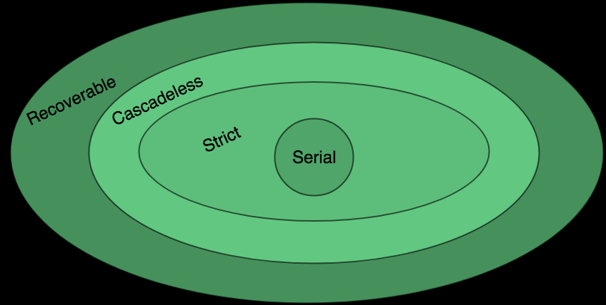
Go, change the world
RV College of
Engineering
Characterizing Schedules based on Recoverability
It is important to note that any strict schedule is also cascadeless, and any cascadeless schedule is also recoverable.
The cascadeless schedules will be a subset of the recoverable schedules, and the strict schedules will be a subset of the cascadeless schedules. Thus, all strict schedules are cascadeless, and all cascadeless schedules are recoverable.

Slide 48
Go, change the world
RV College of
Engineering
Characterizing Schedules based on Serializability
Serial schedule:
A schedule S is serial if, for every transaction T participating in the schedule, all the operations of T are executed consecutively in the schedule. Otherwise, the schedule is called nonserial schedule.
Therefore, in a serial schedule, only one transaction at a time is active—the commit (or abort) of the active transaction initiates execution of the next transaction. No interleaving occurs in a serial schedule.

Slide 49
Go, change the world
RV College of
Engineering
Characterizing Schedules based on Serializability
Problems with Serial Schedules
The problem with serial schedules is that they limit concurrency by prohibiting interleaving of operations. In a serial schedule, if a transaction waits for an I/O operation to complete, we cannot switch the CPU processor to another transaction, thus wasting valuable CPU processing time.
Additionally, if some transaction T is long, the other transactions must wait for T to complete all its operations before starting.
Hence, serial schedules are unacceptable in practice. However, if we can determine which other schedules are equivalent to a serial schedule, we can allow these schedules to occur.
Serializable schedule:
A schedule S is serializable if it is equivalent to some serial schedule of the same n transactions

Slide 50
Go, change the world
RV College of
Engineering
Concept of equivalence of schedules
Result equivalent:
Two schedules are called result equivalent if they produce the same final state of the database.
Conflict equivalent:
Two schedules are said to be conflict equivalent if the order of any two conflicting operations is the same in both schedules.
Conflict serializable:
A schedule S is said to be conflict serializable if it is conflict equivalent to some serial schedule S’.
In such a case, we can reorder the nonconflicting operations in S until we form the equivalent serial schedule S′.

Slide 51
Go, change the world
RV College of
Engineering
Conflicting Operations in a Schedule
Two operations in a schedule are said to conflict if they satisfy all three of the following conditions:
(1) they belong to different transactions;
(2) they access the same item X; and
(3) at least one of the operations is a write_item(X).

Slide 52
Go, change the world
RV College of
Engineering
Conflicting Operations in a Schedule
For example, in a schedule S, (Examples of Conflicting Operations)
the operations r1(X) and w2(X) conflict,
the operations r2(X) and w1(X), (Read-Write conflict)
the operations w1(X) and w2(X). (Write-Write conflict)
However, the examples of non-conflicting operations
r1(X) and r2(X) do not conflict, since they are both read operations;
the operations w2(X) and w1(Y) do not conflict because they operate on distinct data items X and Y; and
the operations r1(X) and w1(X) do not conflict because they belong to the same transaction.
Intuitively, two operations are conflicting if changing their order can result in a different outcome.

Slide 53
Go, change the world
RV College of
Engineering
Serializable Schedules
Being serializable is not the same as being serial
Being serializable implies that the schedule is a correct schedule.
It will leave the database in a consistent state.
The interleaving is appropriate and will result in a state as if the transactions were serially executed, yet will achieve efficiency due to concurrent execution.
Serializability is hard to check.
Interleaving of operations occurs in an operating system through some scheduler
Difficult to determine beforehand how the operations in a schedule will be interleaved.

Slide 54
Serializable Schedules
Go, change the world
RV College of
Engineering
Practical approach:
Come up with methods (protocols) to ensure serializability.
It’s not possible to determine when a schedule begins and when it ends.
Hence, we reduce the problem of checking the whole schedule to checking only a committed project of the schedule (i.e. operations from only the committed transactions.)
Current approach used in most DBMSs:
Use of locks with two phase locking

Slide 55
Go, change the world
RV College of
Engineering
Conflict Serializability
Testing for conflict serializability: Algorithm :
The algorithm looks at only the read_item and write_item operations in a schedule
to construct a precedence graph (or serialization graph), which is a directed graph
G = (N, E) that consists of a set of nodes N = {T1, T2, … , Tn } and a set of directed edges E = {e1, e2, … , em }.
There is one node in the graph for each transaction Ti in the schedule. Each edge ei in the graph is of the form (Tj → Tk ), 1 ≤ j ≤ n, 1 ≤ k ≤ n, where Tj is the starting node of ei and Tk is the ending node of ei.
Such an edge from node Tj to node Tk is created by the algorithm if a pair of conflicting operations exist in Tj and Tk and
the conflicting operation in Tj appears in the schedule before the conflicting operation in Tk.

Slide 56
Go, change the world
RV College of
Engineering
Testing for conflict serializability: Algorithm
Testing for conflict serializability: Algorithm :
For each transaction Ti participating in schedule S, create a node labeled Ti in the precedence graph.
2. For each case in S where Tj executes a read_item(X) after Ti executes a write_item(X), create an edge (Ti → Tj) in the precedence graph.
3. For each case in S where Tj executes a write_item(X) after Ti executes a read_item(X), create an edge (Ti → Tj) in the precedence graph.
4. For each case in S where Tj executes a write_item(X) after Ti executes a write_item(X), create an edge (Ti → Tj) in the precedence graph.
5. The schedule S is serializable if and only if the precedence graph has no cycles.
6. Topological Sorting is used to determine the equivalent serial Schedule from the precedence graph

Slide 57
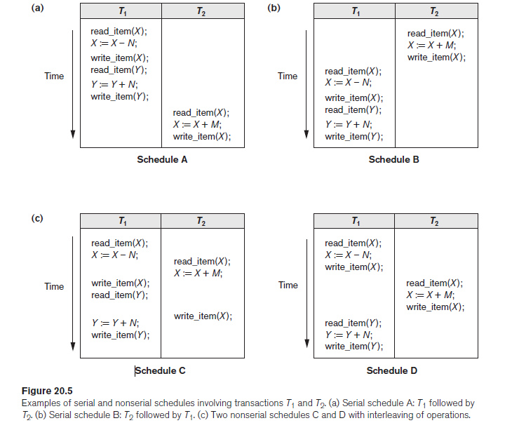
Go, change the world
RV College of
Engineering
Constructing the Precedence Graphs
Example Schedules

Slide 58
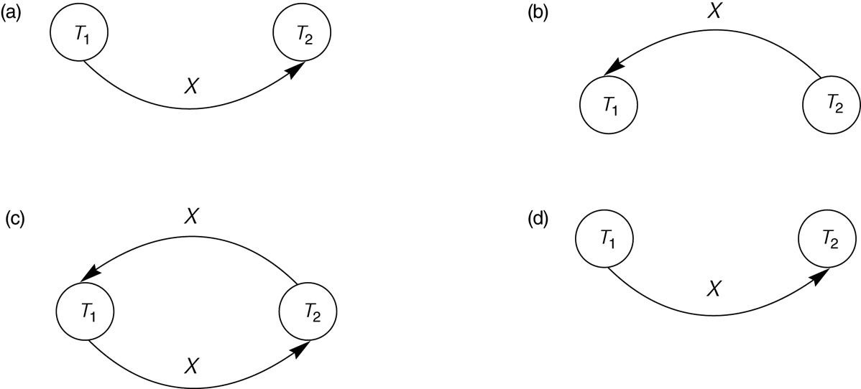
Go, change the world
RV College of
Engineering
Constructing the Precedence Graphs
Constructing the precedence graphs for schedules A and D from Figure 17.5 to test for conflict serializability.
(a) Precedence graph for serial schedule A.
(b) Precedence graph for serial schedule B.
(c) Precedence graph for schedule C (not serializable).
(d) Precedence graph for schedule D (serializable, equivalent to schedule A).

Slide 59
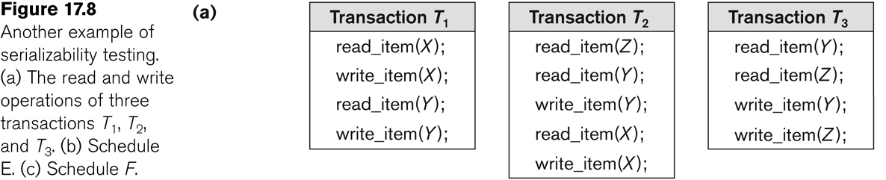
Another example of serializability Testing
Go, change the world
RV College of
Engineering

Slide 60
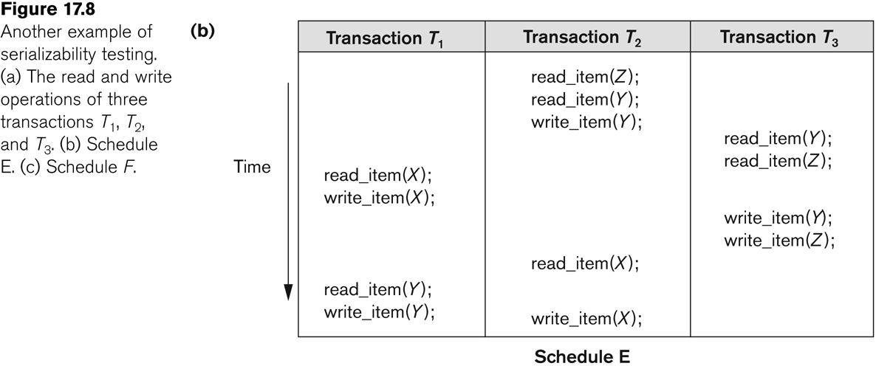
Go, change the world
RV College of
Engineering

Slide 61
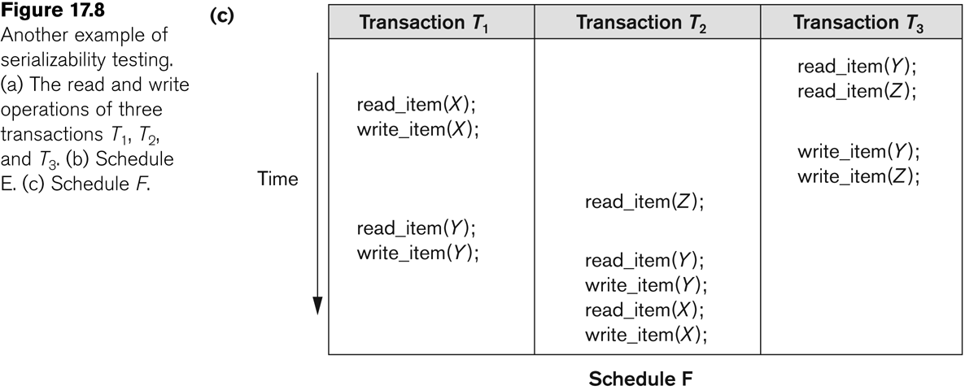
Go, change the world
RV College of
Engineering

Slide 62
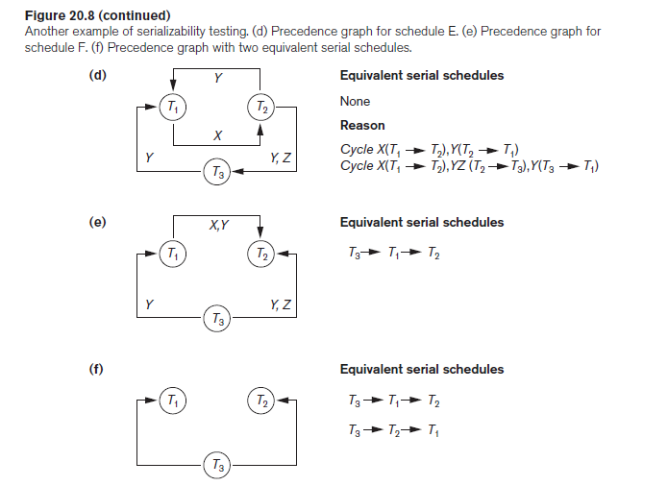
Go, change the world
RV College of
Engineering

Slide 63
Go, change the world
RV College of
Engineering
Other Types of Equivalence of Schedules
Under special semantic constraints, schedules that are otherwise not conflict serializable may work correctly.
Using commutative operations of addition and subtraction (which can be done in any order) certain non-serializable transactions may work correctly

Slide 64
Go, change the world
RV College of
Engineering
Other Types of Equivalence of Schedules (contd.)
Example: bank credit / debit transactions on a given item are separable and commutative.
Consider the following schedule S for the two transactions:
Sh : r1(X); w1(X); r2(Y); w2(Y); r1(Y); w1(Y); r2(X); w2(X);
Using conflict serializability, it is not serializable.
However, if it came from a (read,update, write) sequence as follows:
r1(X); X := X – 10; w1(X); r2(Y); Y := Y – 20;r1(Y);
Y := Y + 10; w1(Y); r2(X); X := X + 20; (X);
Sequence explanation: debit, debit, credit, credit.
It is a correct schedule for the given semantics

Slide 65
Go, change the world
RV College of
Engineering
Transaction Support in SQL2
A single SQL statement is always considered to be atomic.
Either the statement completes execution without error or it fails and leaves the database unchanged.
With SQL, there is no explicit Begin Transaction statement.
Transaction initiation is done implicitly when particular SQL statements are encountered.
Every transaction must have an explicit end statement, which is either a COMMIT or ROLLBACK.

Slide 66
Go, change the world
RV College of
Engineering
Transaction Support in SQL2
Characteristics specified by a SET TRANSACTION statement in SQL2:
Access mode:
READ ONLY or READ WRITE.
The default is READ WRITE unless the isolation level of READ UNCOMITTED is specified, in which case READ ONLY is assumed.
Diagnostic size n, specifies an integer value n, indicating the number of conditions that can be held simultaneously in the diagnostic area.

Slide 67
Go, change the world
RV College of
Engineering
Transaction Support in SQL2
Characteristics specified by a SET TRANSACTION statement in SQL2 (contd.):
Isolation level <isolation>, where <isolation> can be READ UNCOMMITTED, READ COMMITTED, REPEATABLE READ or SERIALIZABLE. The default is SERIALIZABLE.
With SERIALIZABLE: the interleaved execution of transactions will adhere to our notion of serializability.
However, if any transaction executes at a lower level, then serializability may be violated.

Slide 68
Go, change the world
RV College of
Engineering
Transaction Support in SQL2
Potential problem with lower isolation levels:
Dirty Read:
Reading a value that was written by a transaction which failed.
Nonrepeatable Read:
Allowing another transaction to write a new value between multiple reads of one transaction.
A transaction T1 may read a given value from a table. If another transaction T2 later updates that value and T1 reads that value again, T1 will see a different value.
Consider that T1 reads the employee salary for Smith. Next, T2 updates the salary for Smith. If T1 reads Smith's salary again, then it will see a different value for Smith's salary.

Slide 69
Go, change the world
RV College of
Engineering
Transaction Support in SQL2
Potential problem with lower isolation levels (contd.):
Phantoms:
New rows being read using the same read with a condition.
A transaction T1 may read a set of rows from a table, perhaps based on some condition specified in the SQL WHERE clause.
Now suppose that a transaction T2 inserts a new row that also satisfies the WHERE clause condition of T1, into the table used by T1.
If T1 is repeated, then T1 will see a row that previously did not exist, called a phantom.

Slide 70
Go, change the world
RV College of
Engineering
Transaction Support in SQL2
Sample SQL transaction:
EXEC SQL whenever sqlerror go to UNDO;
EXEC SQL SET TRANSACTION
READ WRITE
DIAGNOSTICS SIZE 5
ISOLATION LEVEL SERIALIZABLE;
EXEC SQL INSERT
INTO EMPLOYEE (FNAME, LNAME, SSN, DNO, SALARY)
VALUES ('Robert','Smith','991004321',2,35000);
EXEC SQL UPDATE EMPLOYEE
SET SALARY = SALARY * 1.1
WHERE DNO = 2;
EXEC SQL COMMIT;
GOTO THE_END;
UNDO: EXEC SQL ROLLBACK;
THE_END: ...

Slide 71
Go, change the world
RV College of
Engineering
Transaction Support in SQL2
Possible violation of serializabilty:
Type of Violation
Isolation Dirty nonrepeatable
level read read phantom
_______________________________________________________
READ UNCOMMITTED yes yes yes
READ COMMITTED no yes yes
REPEATABLE READ no no yes
SERIALIZABLE no no no

Slide 72
Go, change the world
RV College of
Engineering
Summary
Transaction and System Concepts
Desirable Properties of Transactions
Characterizing Schedules based on Recoverability
Characterizing Schedules based on Serializability
Transaction Support in SQL

